Slide 1
Sentiment Analysis
TEAM 2

Slide 2
Outline:
Overview
Problem Statement
Business Logic
Key Learning
Sprint Goals
Design Architecture
Working Solution
Future Enhancement

Slide 3

Overview:
Sentiment analysis is contextual mining of text which identifies and extracts subjective information in source material, and helping a business to understand the social sentiment of their brand, product or service while monitoring online conversations.
Sentiment analysis is extremely useful in social media monitoring as it allows us to gain an overview of the wider public opinion behind certain topics.

Slide 4
Problem Statement
This project aims at collecting data and analysing it dynamically based on keyword entered by the user. Sentiment analysis is applied over data collected from twitter to get insight of the opinions of customers and a word cloud is generated over top relevant words.

Slide 5
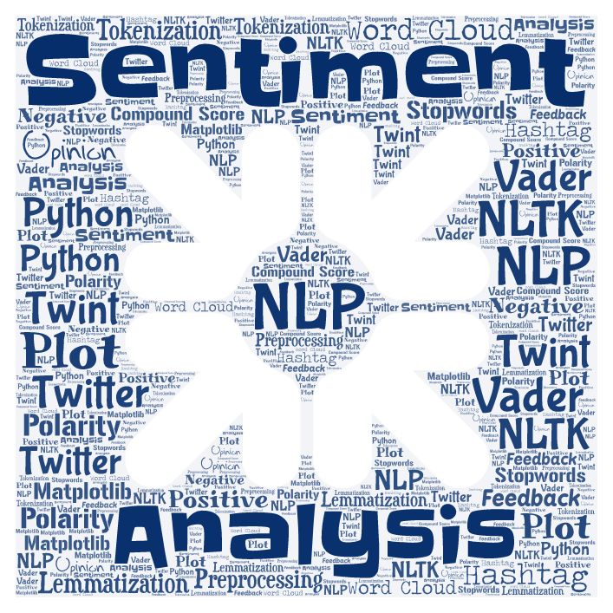
Approach:

Slide 6
Business Perspective:
Looking at the bigger picture allows you to truly listen to the voice of your customer, identify trends, pinpoint problems and essentially extract more “business” value.
The sentiment analysis answers the following aspects:
Key aspects of a brand’s product and service that customers care about.
Users’ underlying intentions and reactions concerning those aspects.

Slide 7
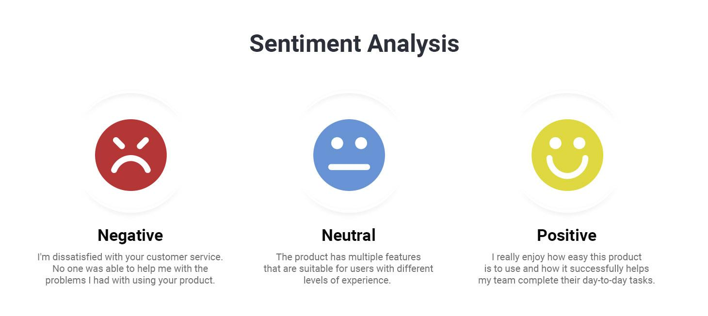

Slide 8
Key Learning:
Working with technologies
Coordinating in a team
Corporate culture

Slide 9
Sprint Goals:
Week 1
Selecting tools and libraries to work with
Week 2
Designing solution and sourcing data
Week 3
Developing part of solution and presenting them to mentors for feedback
Week 4
Refining work: Dynamically achieving results and visualising

Slide 10
Design Architecture:
Twitter Handle Scrapper
Remove URLs
English Dictionary Creation
Extraction of words
Stemming
CSV file of crawled tweets
Data Collection
Data preprocessing
Generation of Sentiment Metric
Vader Sentiment Analysis
Text file containing preprocessed word set
Word Cloud Generation
Visualization
Data Analysis

Slide 11
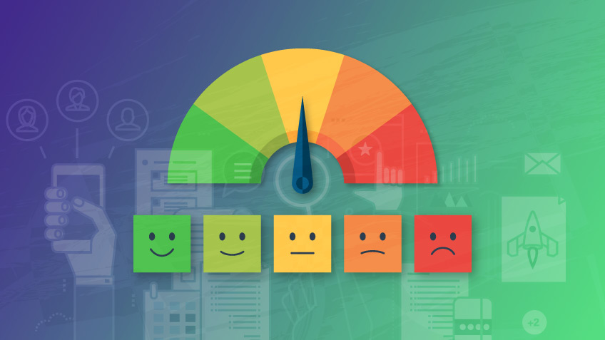
Implementation Screenshots:

Slide 12
Challenges:
Selecting tool for data scraping.
Preprocessing: removing urls and handles
Vader sentiment vs Text Blob
Making the application dynamic
Implementation as a web app

Slide 13

Future Enhancements
Implement Geo-fencing
Implement different analyzers for various other languages

Slide 14
Q&A

